Slide 1
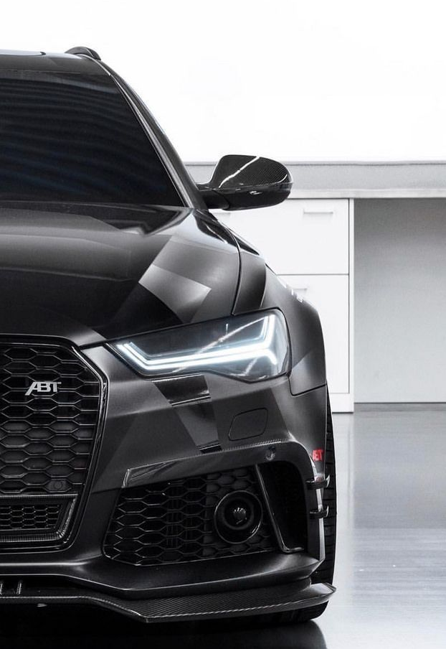


DREAM CAR
29/11
Supervisors
Dr. Sally Saad
TA. Mohamed Musa

Slide 2
Teammates
Mohamed Emad
Youssef Ahmed
Mahmoud Ahmed
Alaa Ashraf
Sumaya Shaaban
Menna Allah Bassam
CS Department

Slide 3
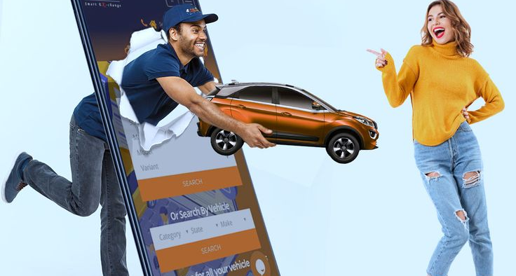
Agenda
Introduction
Background
Motivation
Objectives
Related work & Applications
System Architecture (Phase Diagram)
Phases description
Time plan
Tools & References

Slide 4

Introduction
In an ever-evolving automotive landscape, buying and selling cars often involves information overload, a lack of personalized recommendations, and inefficiencies in connecting buyers with suitable sellers.

Slide 5
Background
In the contemporary automotive market, traditional methods of buying and selling cars are gradually giving way to digital platforms. The transition to online car shopping systems offers numerous benefits, including convenience, a broader market reach, and streamlined transactions. However, with this shift comes a set of challenges that need to be addressed for an efficient and secure online car shopping experience.

Slide 6
Motivation
Convenient Car Buying and Selling Process
Special specifications and budget
Comprehensive car comparison
Instant car details via photo
Enhanced user experience

Slide 7
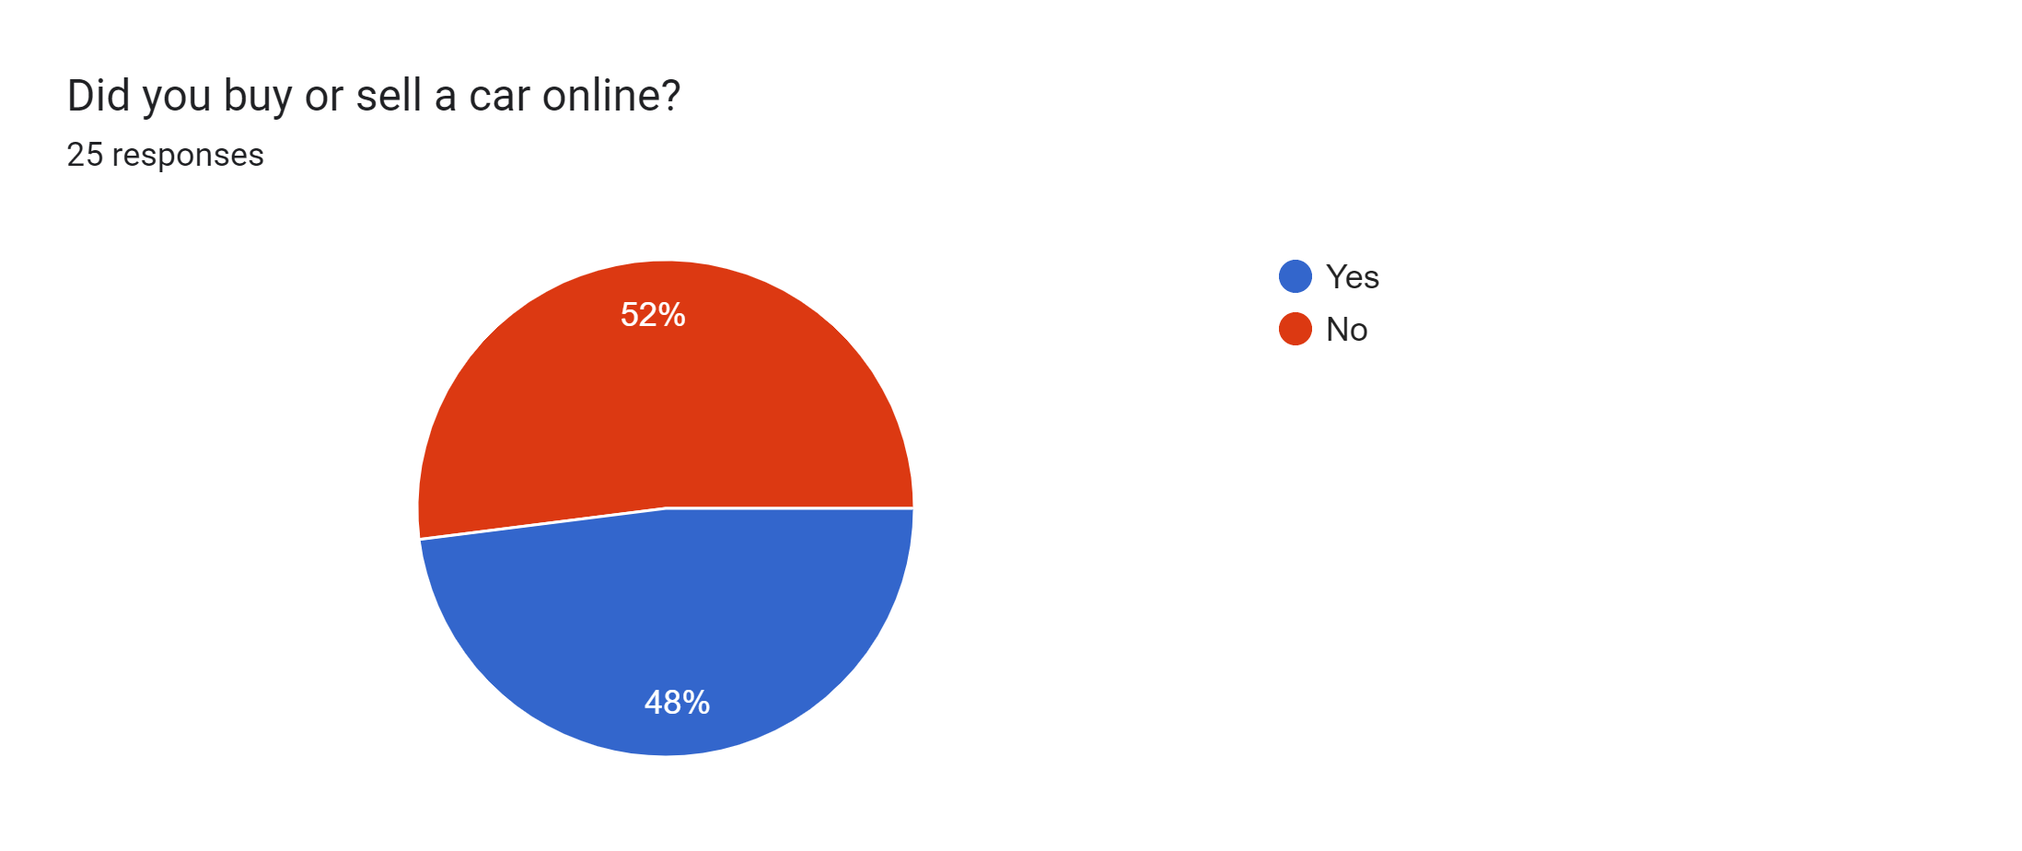
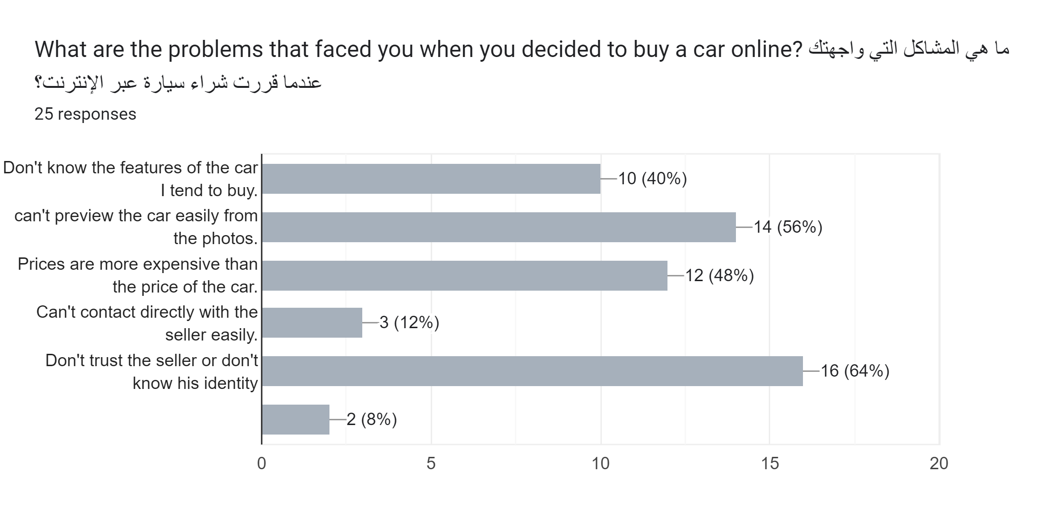
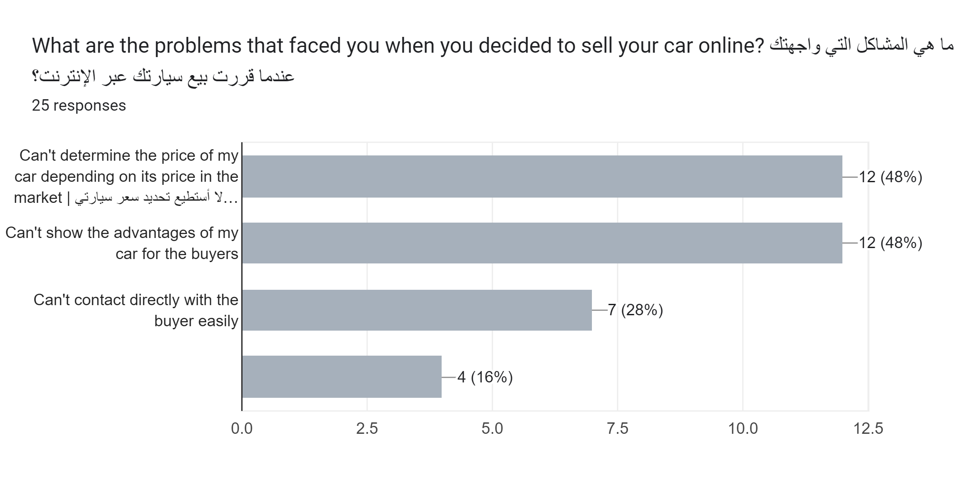
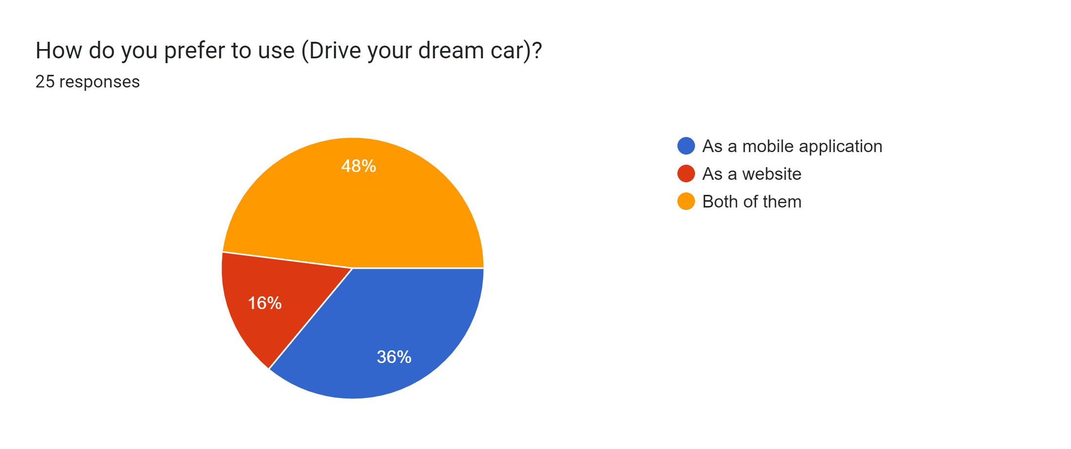
End Users Opinion

Slide 8
Objective
Provide Accurate Vehicle Information: Provide buyers with complete information about listed vehicles (specifications, conditions, and history reports) Facilitate the process of displaying and selling used cars. .
Optimize Pricing Strategies: Assist sellers in setting competitive prices based on market trends, ensuring fair value for both buyers and sellers.
Enable Effective Communication: Facilitate communication channels between buyers and sellers to enhance negotiation and overall interaction.
Determine car identity: Providing access to information and knowledge about any car through a picture.

Slide 9
Related work
Papers
application

Slide 10
Related work
Paper | Year | Methods | Dataset | Evaluation
An Optimal BDCNN ML Architecture For Car Prediction | 2022 | Develop A CNN- Inspired MMR Framework For Automobile | Using The Comp Cars Dataset And Other Sources | 92.7%
Car Logo Extraction | 2020 | VGG And Res Net | Openalpr Benchmarks | 79%

Slide 11
Related work
Paper | Year | Methods | Dataset | Evaluation
Real-Time Vehicle Make and Model Recognition | 2008 | CNN Residual Squeeze Net | openALPR | 93%

Slide 12
Application
CarMax
Autotrader
Cars.com
OpenSooq
Hatla2ee

Slide 13
System architecture

Slide 14
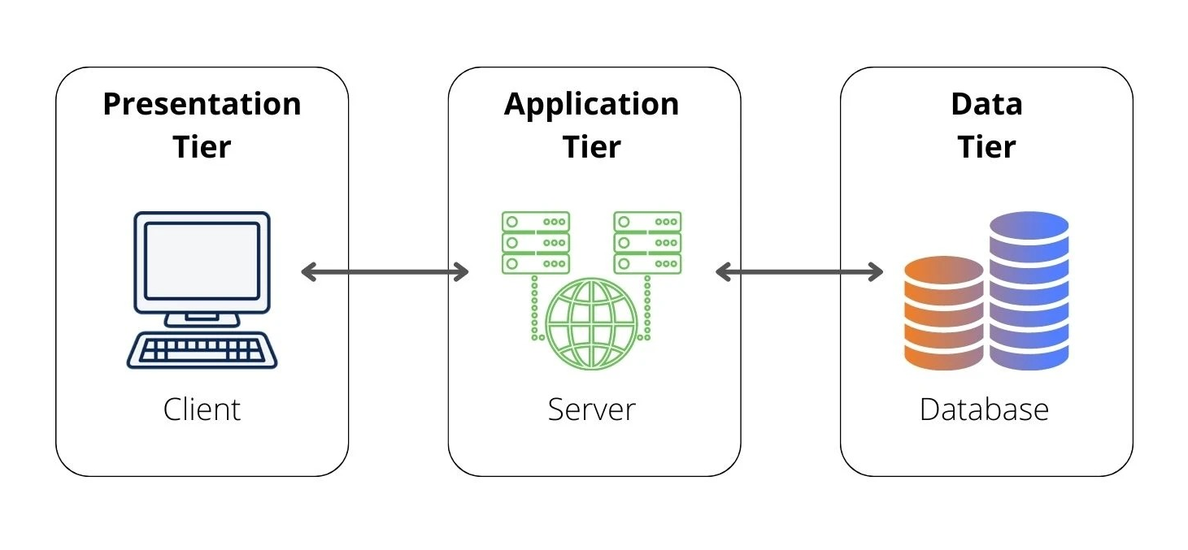
System architecture
Abstraction of System

Slide 15
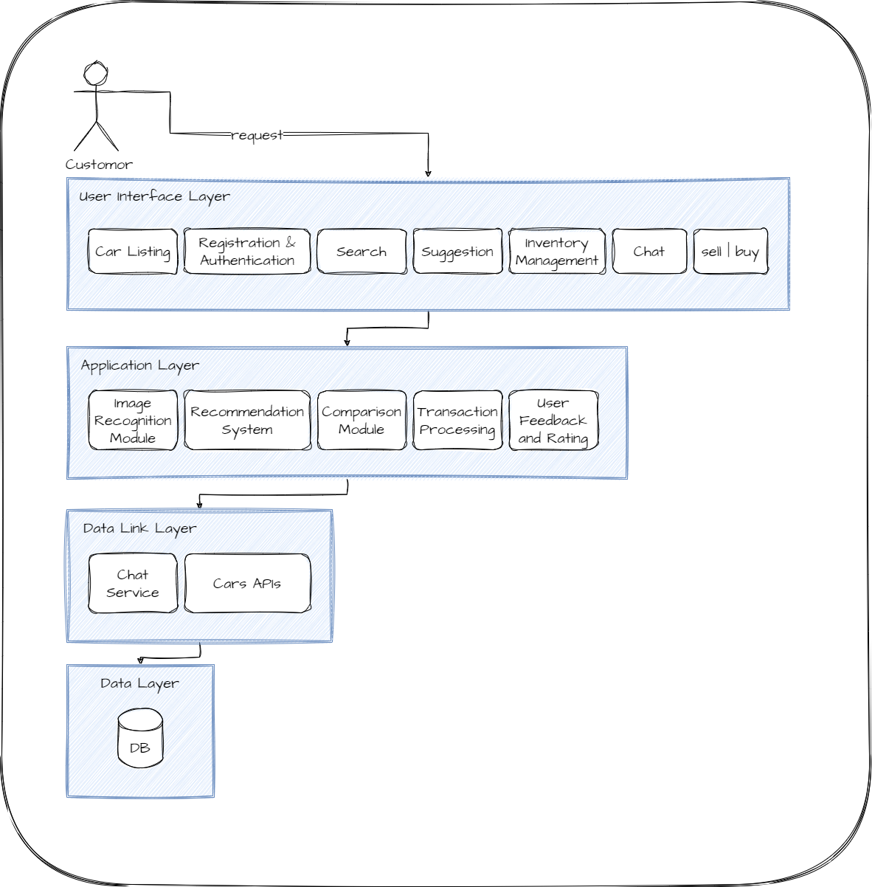
System architecture
UI Layer
Application Layer
Data Link Layer
Data Layer

Slide 16
Pipeline
Requirements Gathering
System Design
Development
Testing
Deployment
Launch

Slide 17

Phases description
Requirements Gathering:-
identify and document functional and non-functional requirements.
Gather user stories and use cases.
Define system features and functionalities.

Slide 18

Phases description (cont..)
System Design:-
Design the database schema.
Define the logic and data link layers.
Identify external services and APIs to integrate.

Slide 19
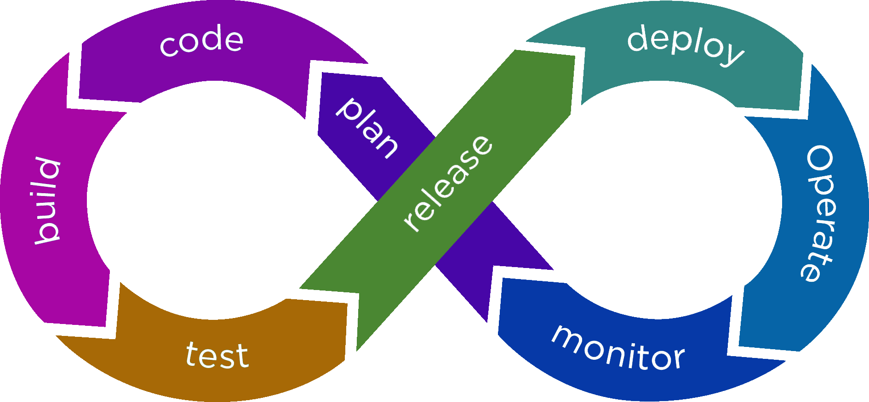
Phases description (cont..)
Development:-
Implement front-end components (UI/UX).
Develop back-end services and logic.
Integrate external services and APIs.
Implement database functionality.

Slide 20

Phases description (cont..)
Testing:-
Conduct unit testing for individual components.
Perform integration testing to ensure components work together.

Slide 21

Phases description (cont..)
Deployment:-
Deploy the application to a live server.

Slide 22

Phases description (cont..)
Lanch :-
Officially launch the car marketplace.
Monitor system performance and user interactions.

Slide 23
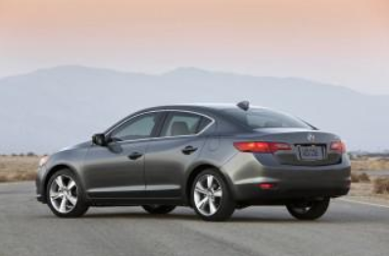
The Chosen Dataset
"Car Brands - Car Connection Picture" Dataset.
Dataset is taken from a popular website for Car research ”kaggle”.
the dataset is suitable for the purpose of developing the model.

Slide 24
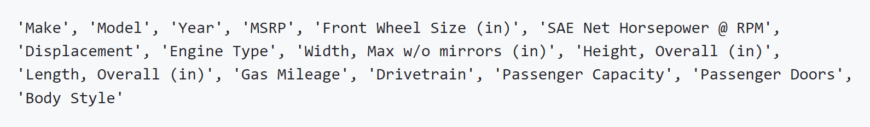
The Dataset info..

Slide 25
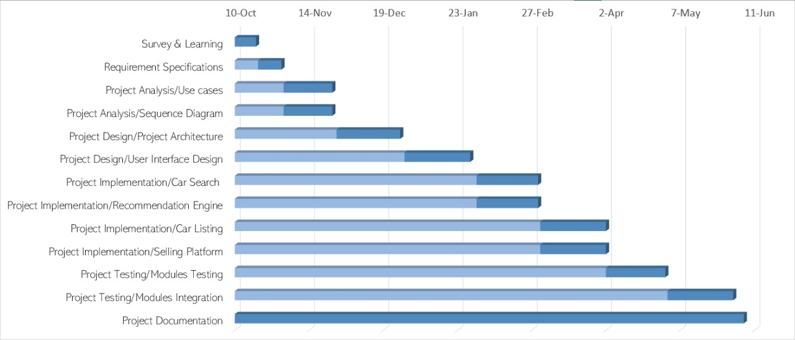
Time plan

Slide 26
Tools
Front-end
Back-end

Slide 27





Tools (Front-end)
Visual Studio Code

Slide 28






Tools (Back-end)
NodeJs
Python
MongoDB
Pycharm

Slide 29
References
Car Recommendation Systems
Image Recognition and Car Identification
User Experience and Interface Design

Slide 30
References
1.Car Recommendation Systems:
"A Collaborative Filtering Recommendation Algorithm for Car Purchase" by Q. Li et al. (2014)
"A Novel Vehicle Recommendation Algorithm Based on Collaborative Filtering" by W. Luo et al. (2017)Cutting-Edge Image Recognition
"A Hybrid Car Recommender System Based on Collaborative Filtering and Content-Based Filtering" by X. Li et al. (2020)Assisting end users

Slide 31
References
2. Image Recognition and Car Identification:
- "Deep Learning-Based Car Recognition with Image Retrieval" by L. Li et al. (2020)
Car Make and Model Recognition Using Convolutional Neural Networks" by T. Tsantekidis et al. (2019)
3. User Experience and Interface Design:
"User Experience Design Guidelines for Successful Human-Computer Interaction" by M. Alhaddad and S. Aljohani (2019)
"User Interface Design for Mobile Applications: Challenges and Solutions" by P. Isaias et al. (2012)

Slide 32

Any Question

Slide 33
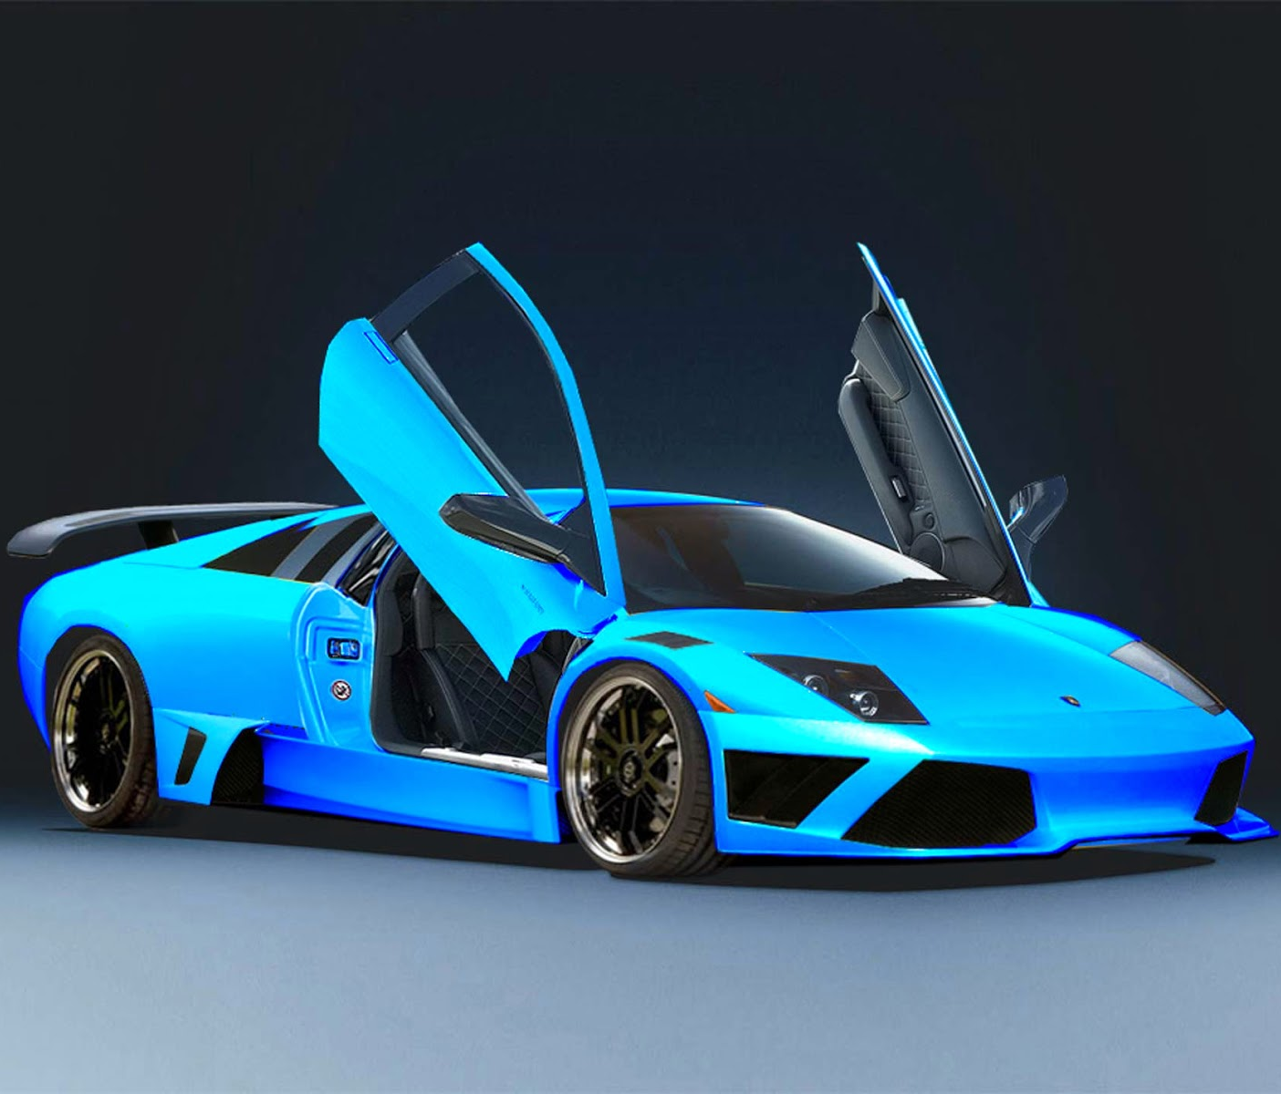
THANK YOU

